Slide 1
DevOps CI / CD

Slide 2

Agenda
In this session, you will learn about:
CI-CD Practical scenario

Slide 3



CI-CD Pipeline scenario using Jenkins
Deployment Dashboard on Jenkins.
Link to Artifacts
GITHUB repo
Jenkins Box
(Jenkins as a service)
http://locahost:9001
Plugins:
JIRA plugin
Artifactory plugin
GITHUB plugin
Shell / Batch plugin
Linux Box
Artifactory repository (On Linux)
http://192.168.33.27:8081
Create Repository.
JIRA Tool (On Linux)
http://192.168.33.26:8080
Create Project
Create Issues type to accept
Archive Artifacts
Deploy
Create Issues / Update Issue / update release
TOMCAT Application Server
http://localhost:8080

Slide 4
Continuous Delivery Pipeline
GITHUB
Jenkins
Repo1
Repo1
Repo1
Dev environment
Test1 environment
Test2 environment
Automated Testing and Build
Automated Testing and Build
Automated Testing and Build

Slide 5
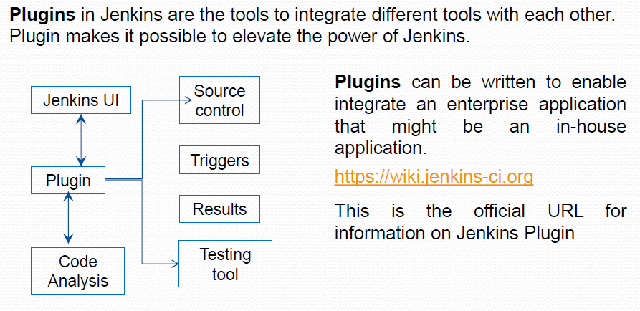
Jenkins Plugins

Slide 6
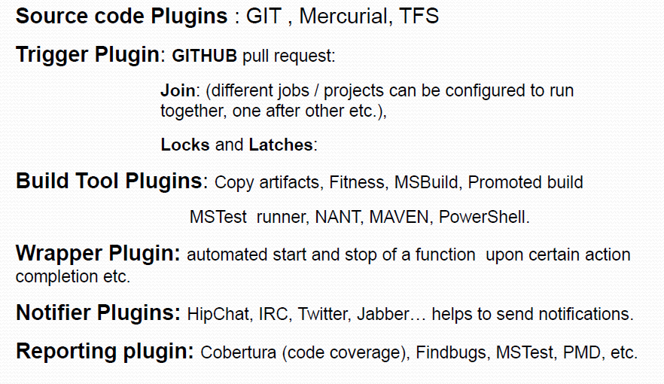
Using Plugin to Integrate Tools

Slide 7
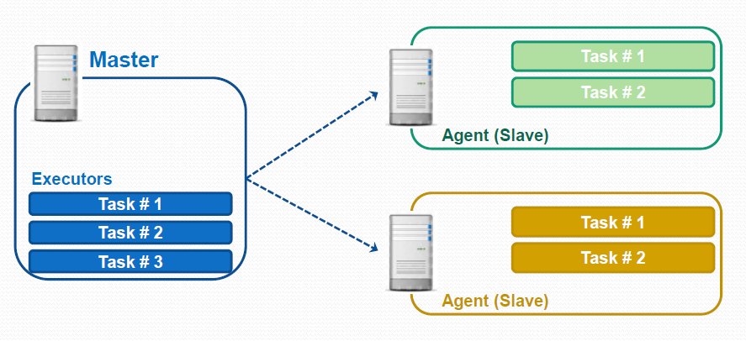
Master – Agent Model : Jenkins Nodes

Slide 8
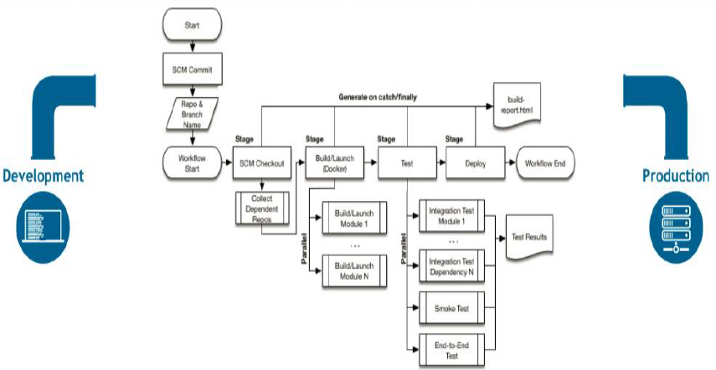
Jenkins Pipeline View

Slide 9
www.cognixia.com

